Slide 1
Music Store Data Analysis

Slide 2
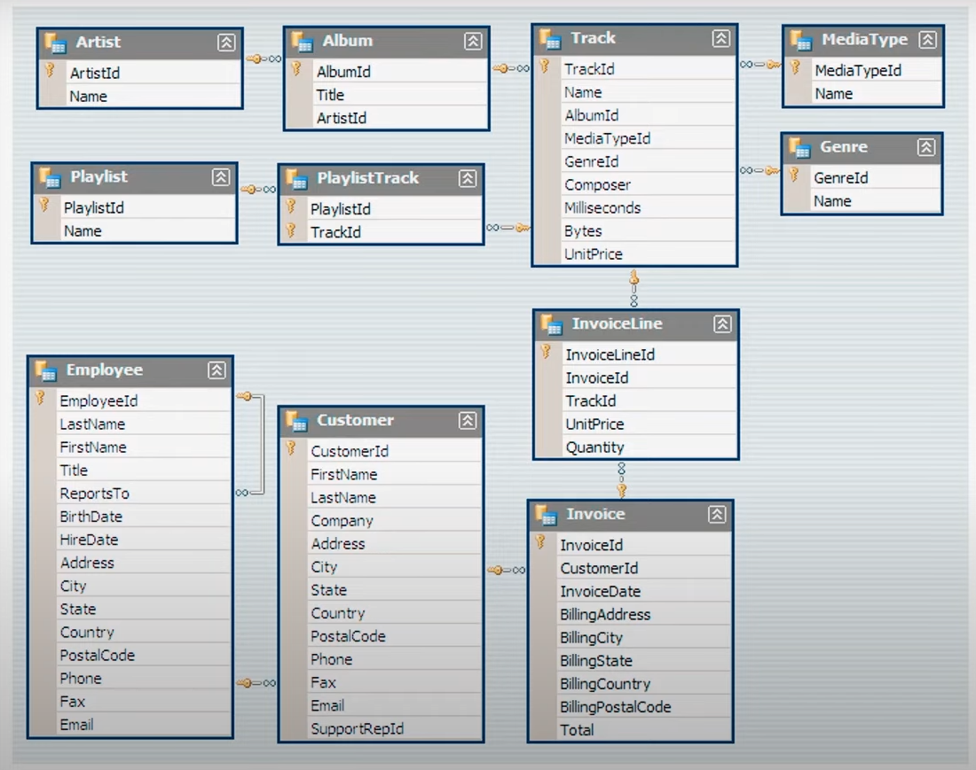
DATABASE SCHEMA

Slide 3
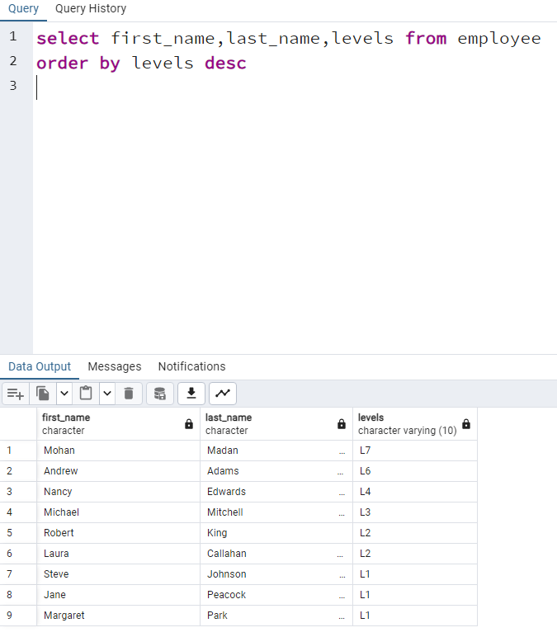
Q1: Who is the senior most employee based on job title?
Madan Mohan is the senior most employee and is currently at Level 7

Slide 4
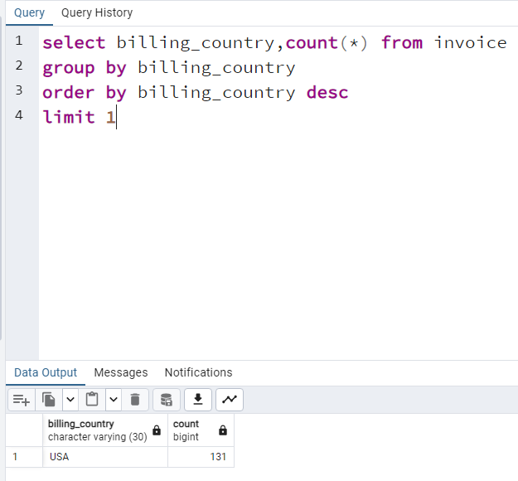
Q2: Which countries have the most Invoices?
Country USA has the most number of invoices.

Slide 5
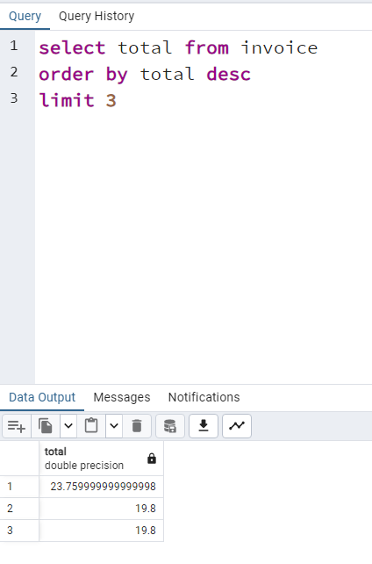
Q3: What are top 3 values of total invoice?
The top 3 values from the total Invoice column are
23.75
19.8
19.8

Slide 6
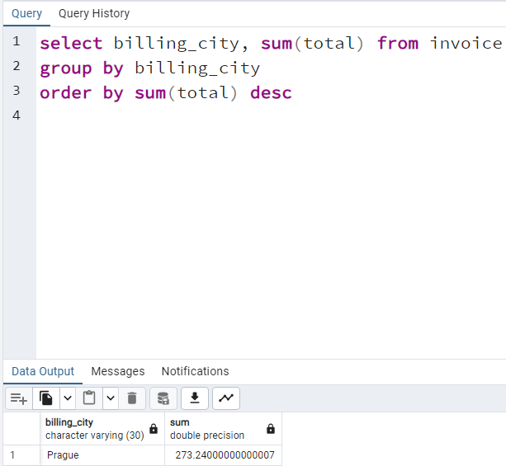
Q4: Which city has the best customers? We would like to throw a promotional Music Festival in the city we made the most money.
Most amount of money was made in the City “Prague”.

Slide 7
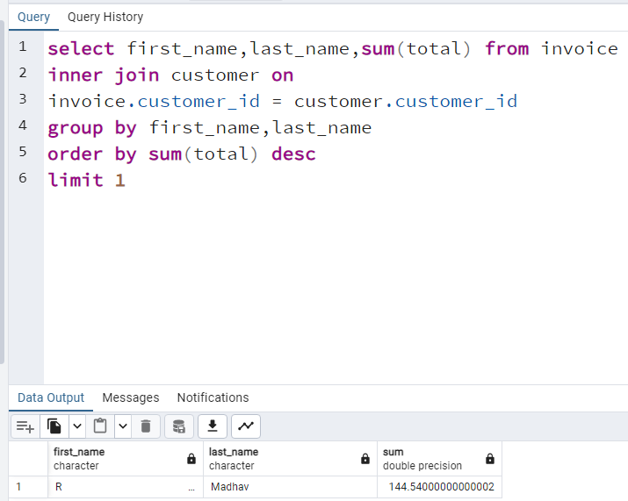
Q5: Who is the best customer? The customer who has spent the most money will be declared the best customer.
Customer R Madhav has spent the maximum amount of money.

Slide 8
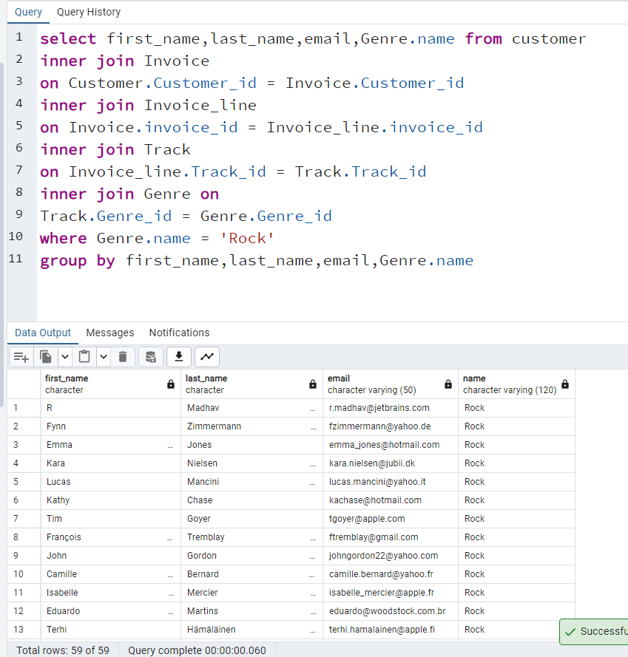
Q6: Write query to return the email, first name, last name, & Genre of all Rock Music listeners.
There are 59 customers who listen to “Rock” genres

Slide 9
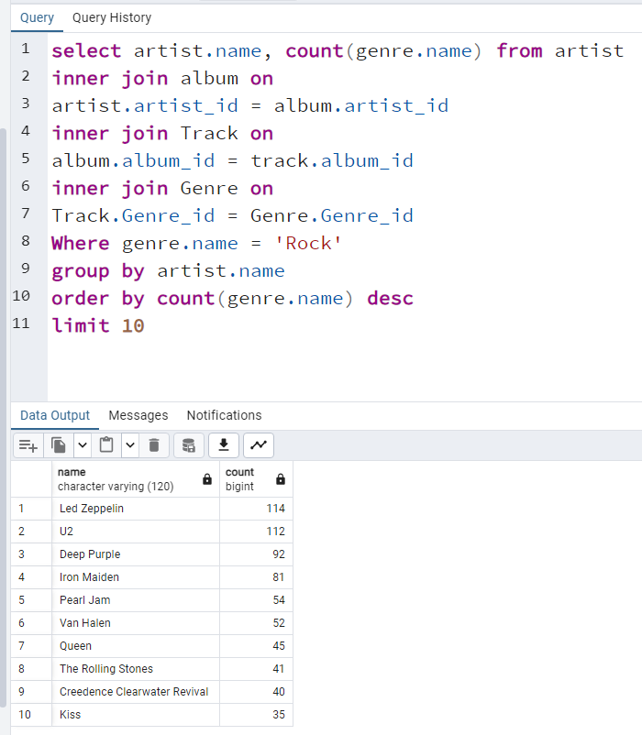
Q7: Let's invite the artists who have written the most rock music in our dataset. Write a query that returns the Artist name and total track count of the top 10 rock bands.
Led Zeppelin has a total track count of 114 tracks in the Rock Genre

Slide 10
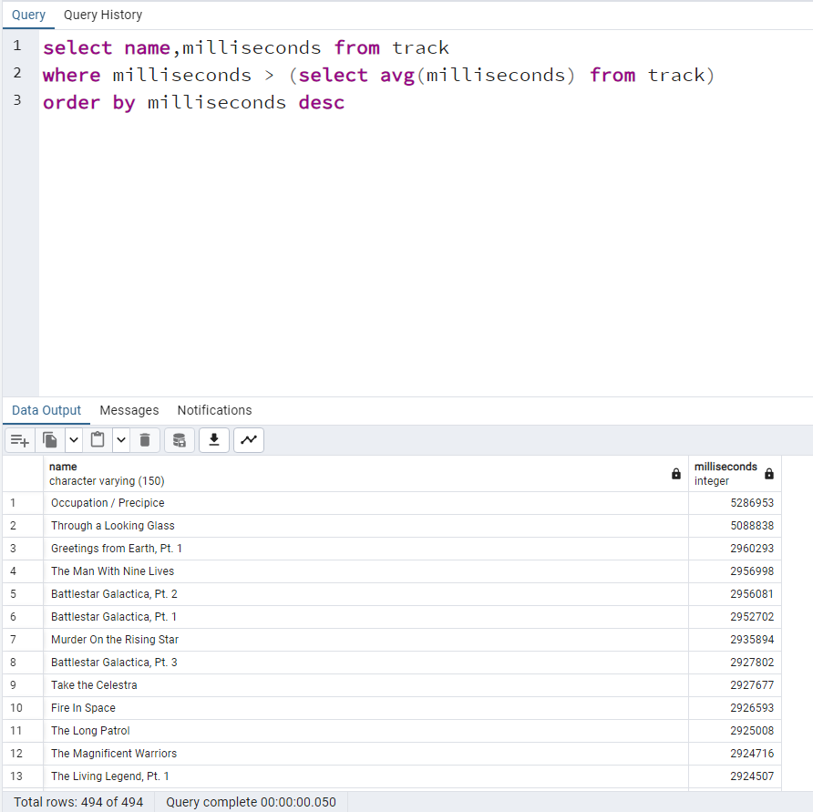
Q8: Return all the track names that have a song length longer than the average song length. Return the Name and Milliseconds for each track. Order by the song length with the longest songs listed first.
Occupation/Precipice track has the longest length

Slide 11
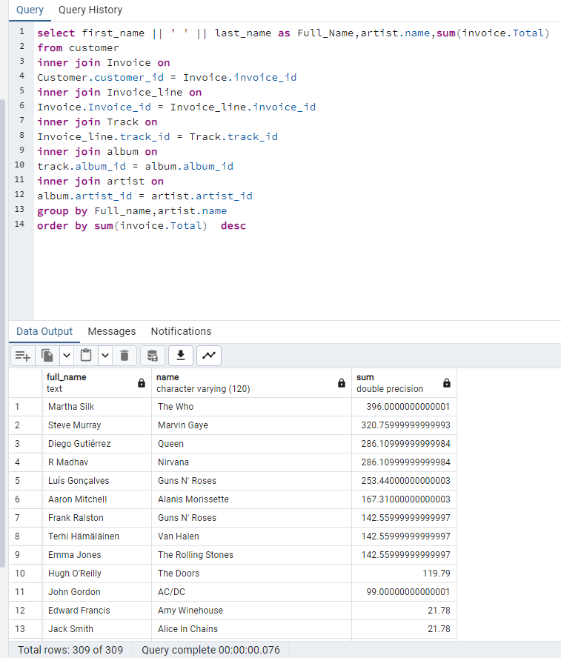
Q9: Find how much amount spent by each customer on artists? Write a query to return customer name, artist name and total spent
Martha Silk has spent the highest amount i:e “396” on artist “The Who”.

Slide 12
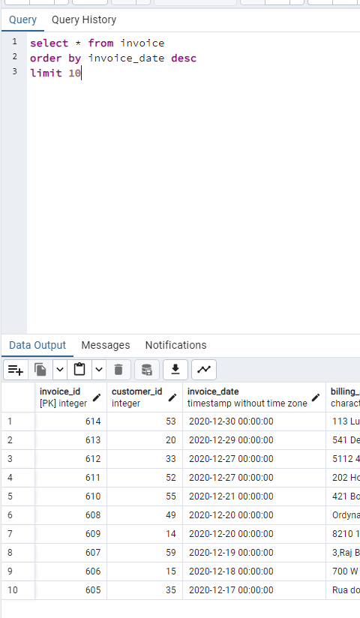
Q10: Retrieve the 10 latest generated invoices
Invoice_id ‘614’ is the latest invoice generated

Slide 13
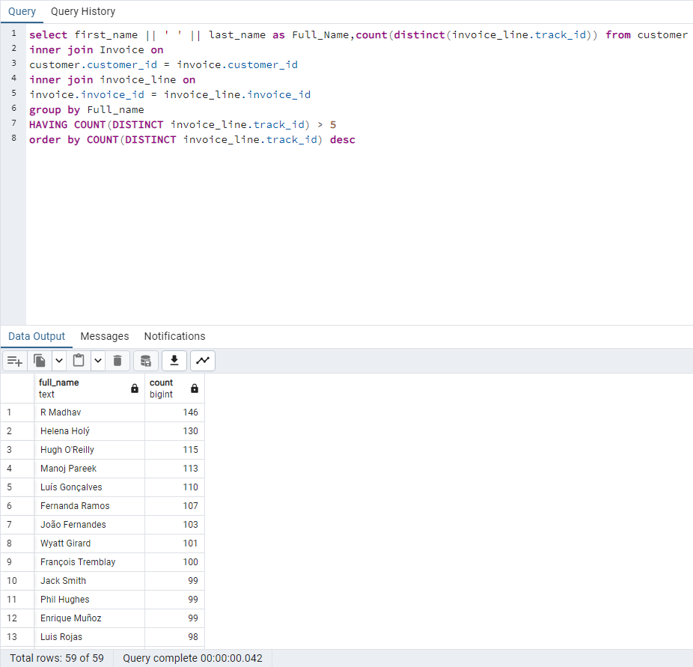
Q11: List the customers who have purchased more than 5 unique tracks
R Madhav has purchased the most number of unique tracks.

Slide 14
Thank You

